Slide 1
Children First
Early Permanence Seminar Series
Tuesday 6 June 2017
The Foundling Museum
Chaired by District Judge Celia Dawson

Slide 2
6th June 2017
Cafcass and Coram
Anthony Douglas CBE, Chief Executive, Cafcass

Slide 4
The adoption triangle over a lifetime
Adoption sets up a false binary opposition between birth parents and adopters – a Venn diagram is more realistic.

Slide 5
Contact today
Contact is not a bargaining tool at the court room door, nor a rights-fest e.g., indirect contact is just as complex.
Interim contact needs are for children, not parents.
Long-term contact needs should recognise the reality for the 21st century child e.g. use of Facetime and Skype.
Contact should not be polarised to mother v father, but should flow from the child’s world, where many children need to stay in touch with siblings and friends as much as parents – the child’s contact network.

Slide 6
A culture of urgency
Care cases project managed from the day a child comes into care to the day she or he leaves (using a case tracker)
Case plans setting out what needs to be done with any issues about gaps in evidence resolved
A timetable that takes into account emotional and psychological processes, as well as court and bureaucratic processes
A culture change in teams and individuals - to a culture of urgency
Inclusive, problem-solving practice – the team around the child in court
A concurrent 6 month maximum for all stages of the care and placement process- impossible with serial professionals and multiple placements
Extended viability assessments (6-8 weeks) before care proceedings, leading to a single proposition for children subject to care proceedings wherever possible, still within the parameters of the PLO

Slide 7
Early permanence options: the balancing exercise
EARLY PERMANENCE ANALYSIS, INCLUDING A WELFARE AND PROPORTIONALITY ANALYSIS OF THE PROPOSED PLACEMENT AND CONTACT FRAMEWORK
Safe reunification | Evidence (including structured professional assessment)
Kinship care | Evidence (including structured professional assessment)
Permanent (long-term) fostering | Evidence (including structured professional assessment)
Adoption | Evidence (including structured professional assessment)
Special guardianship | Evidence (including structured professional assessment)
Residential care | Evidence (including structured professional assessment)

Slide 8
Lines of enquiry
Dad commits to child
Concerns expressed by mum about PGM
Mum’s sister assessed for viability
PGM, already a permanent carer for 2 grandchildren, positively assessed for viability
Mum engages with social worker on a contract to enter drug rehab
MGM commits to safe shared care with child
PGF health issues
EVIDENCE BASE
After social work input, mum supports kinship care placement with PGM
Permanence assessment of PGM and PGF concludes positively in 5 weeks
Their assessment concludes this will keep both mum and dad positively involved in child’s upbringing
PGF health issues resolved

Slide 9
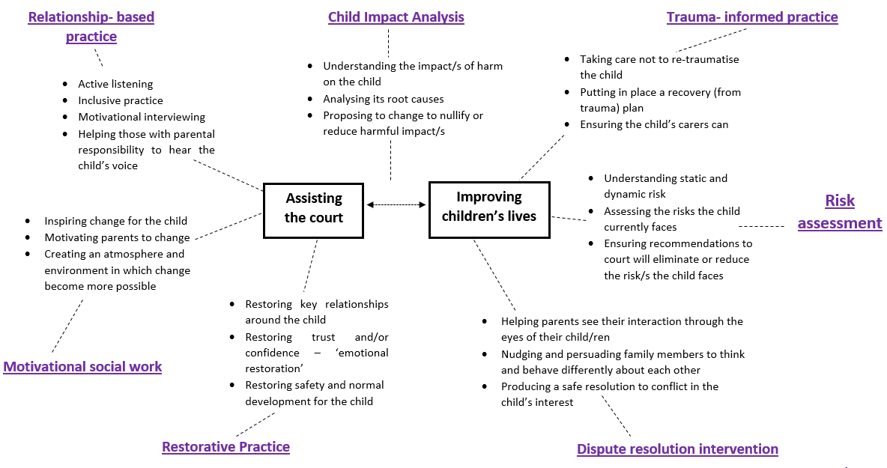
The eclectic model of social work in Cafcass

Slide 10
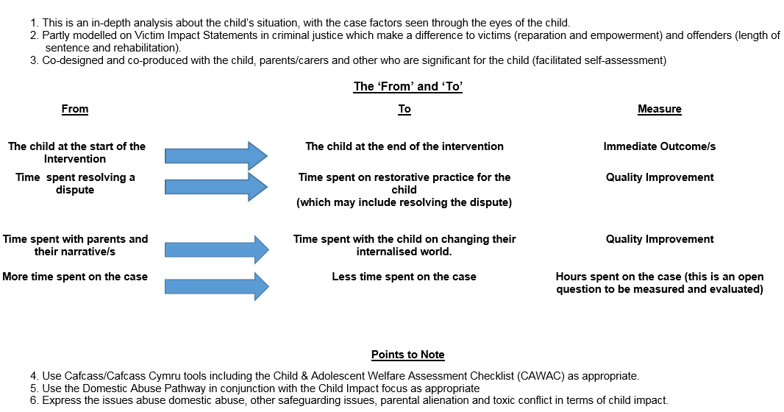
Child Impact analysis in court reporting

Slide 11
It takes time to get used to the idea
Hi Anthony,
Remember me I was the LAC manager in ……. when you were there (and also worked in EAT). I know I talked with you about myself and D adopting a child – well it is now happening ! We are adopting a little boy, Kemal. Introductions start on 20/02/2017 !
D is still working for Shell – he took retirement but later returned to help out – I sent him back out to work – well it just was not right me working full time whilst he was able to lie in !! Now we will both be taking time off. We were sorting our book cases out and I came across your book about Adoption, which I intend to read again !
Anyway I hope you are keeping well and if you still come to … we should try to catch up !!
Warm regards,
P
I worked in …… from 2002 – 2004.

Slide 12
Guardian’s role in foster to adopt placements
Clea Barry

Slide 13
London Guardians experiences
Cases that went extremely well
Cases where there were issues, dilemmas, questions and hesitations
Cases where foster to adopt placements were considered but didn’t happen

Slide 14
Children were everything went well
‘The carers were exceptional, I couldn’t quite believe it was real.’
‘The carers were so insightful because of the extra training and support they had received’
‘It was fantastic for this baby, she was able to go straight home from the hospital and just stay there without moving
‘They were willing to support direct contact with the parent’
‘It was wonderful, she did really well and was a lovely, much loved baby’
‘There was something extra about the quality of care they gave’

Slide 15
Common factors where everything went well
Relinquished or abandoned babies
Well planned from early in the pregnancy
Some were placed from hospital
Second siblings placed with a child who was already adopted and settled
Good cultural matches

Slide 16
Families where there were issues, hesitations, dilemmas
Complex legal or international issues
Difficult trade offs in terms of matching or contact
Parents with complex and possibly inheritable health issues
New information coming to light during the proceedings
Older children, short time scales
Placements where the child did not remain with the carers because a family assessment was positive
Contact was very difficult and it placed a lot of pressure on the placement

Slide 17
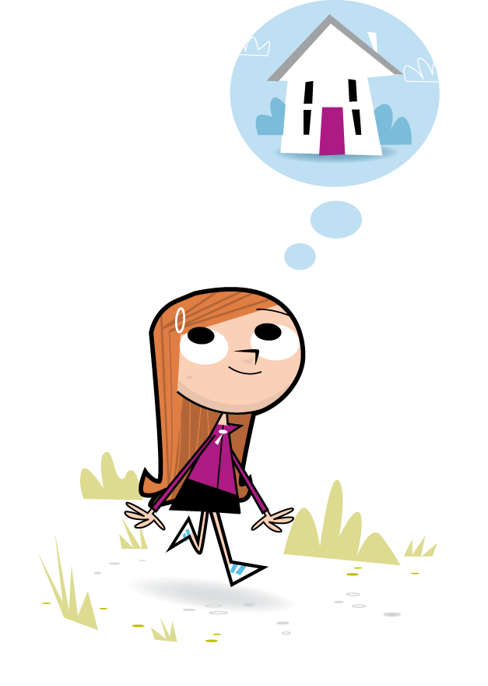
Learning and the guardians role
Preparation and information for the adopters about this particular child
Timing of the decision and the move
The dual edged nature of the investment the carers had in the children
Highly emotive cases

Slide 18
Cases where foster to adopt was considered but didn’t happen
‘I raised it with the social worker and the IRO but they said there was not a placement available.’
I supported the LA’s proposal for foster to adopt but the judge thought it was premature.
The social worker wanted foster to adopt but had not considered placement with the older siblings and this needed careful consideration and support
I thought rehabilitation was a real possibility so couldn’t support foster to adopt

Slide 19
Learning from the nearly cases
Timing of the decision
Looking at all the options
Guardians role in asking difficult questions and scrutinising the care plan early on
Proactive work by IROs and Guardians early on in the case
Decisions made very early on can have very long lasting implications

