Slide 1
AI for Good
A webinar presented by EY
December 2024

Slide 2
Agenda
1
2
3
4
5
Introductions
What is AI?
AI in practice
Starting your AI journey
Q&A

Slide 3


Introductions
Andy Fuller
Peter Capsalis

Slide 4
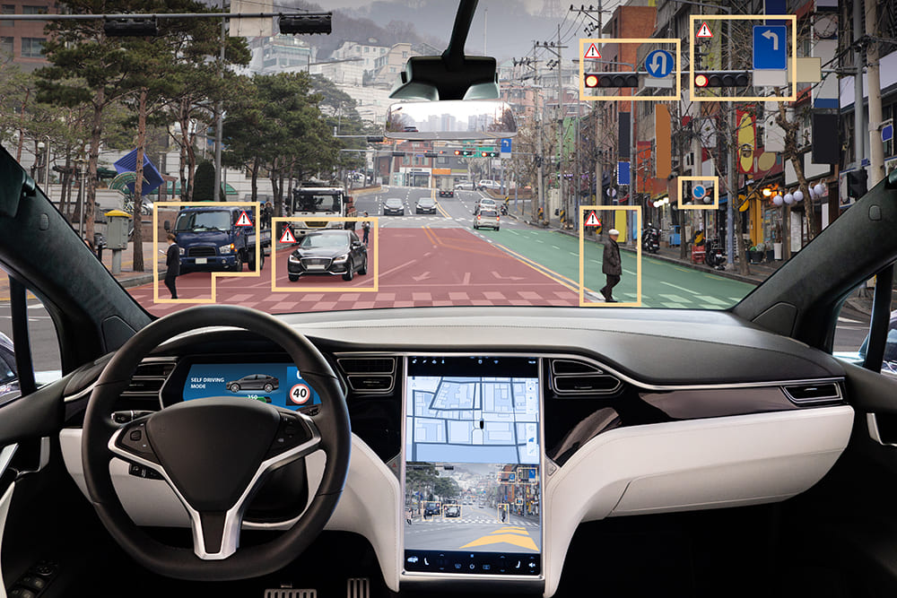
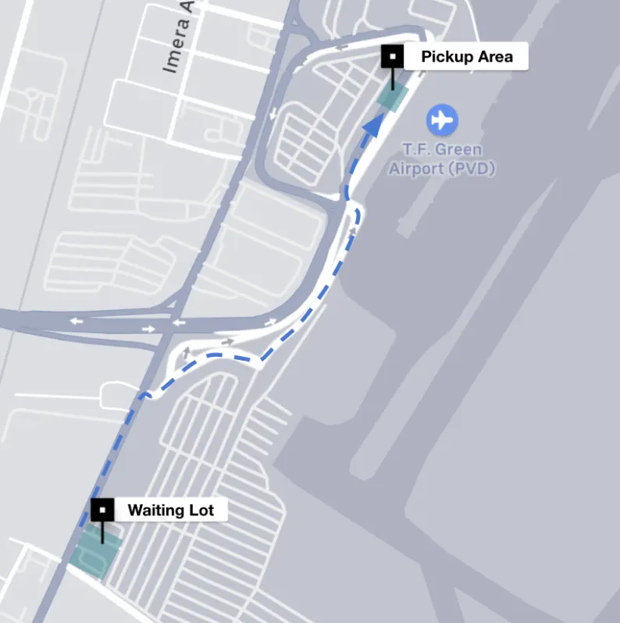



What is AI? Definitions and Concepts
Artificial Intelligence is a field where computers are trained to "think" like humans
Self driving cars use Video AI to detect what is on the road.
Ride sharing apps use a routing algorithm to get people where they want to go
ChatGPT using a Large-Language-Model to provide text summarization
What is something you would love an AI Intern to do for you?

Slide 5
AI seems like it’s come from nowhere..
  Technology Appearance
  Artificial Intelligence
AI, or artificial intelligence, is a field of computer science that focuses on creating intelligent machines capable of tasks requiring human intelligence.
1943
  Machine Learning
Machine learning is a subfield of artificial intelligence, which is broadly defined as the capability of a machine to imitate intelligent human behaviour.
1959
  Deep Learning
Deep learning is a subset of machine learning, which is essentially a neural network with three or more layers.
Artificial
Intelligence
Machine
Learning
Deep
Learning
Generative
AI
2006
Generative AI
Generative AI is a type of artificial intelligence that can create new content such as images, text, audio, or video based on the data it has been trained on, using techniques like large language models, transformer neural networks, and generative adversarial networks
2017

Slide 6





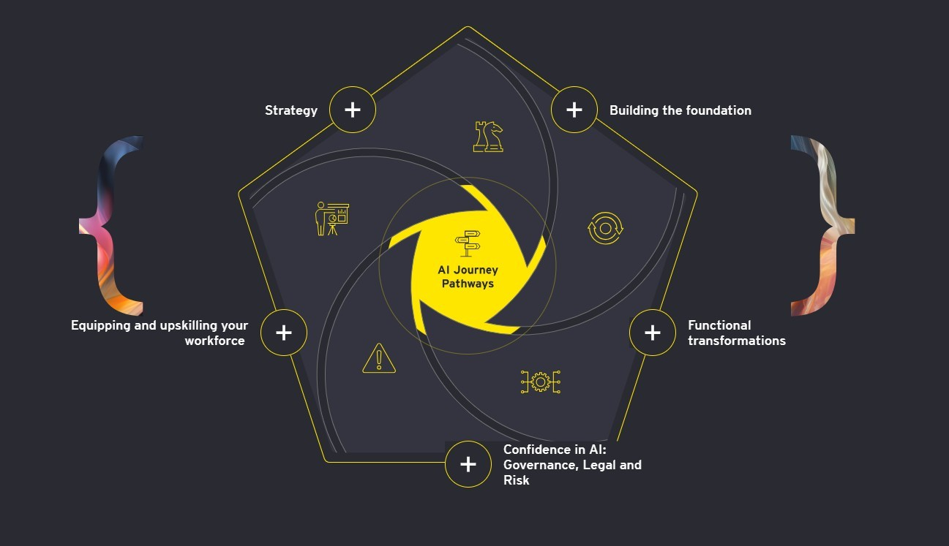







What are the different types and uses of AI?
Document Analysis
Chatbots
Object Recognition
Computer Vision
+
+
Cognitive AI
Language Translation
Voice Transcription
5 Types of AI
Personalised Agents
Content Creation
Agentic AI
+
+
Generative AI
Text Summarisation
Enabling Digital Interaction
+
AI for Prediction
Behaviour Prediction
Forecasting

Slide 7





What AI can do – day in the life of a case worker
Real time intelligence
Past visits
Other events related to the property
Summarize historical case notes
Recommendations for what needs to be done in the visit
Automated note-taking and transcription

Slide 8



Admin Benefits of AI – What good looks like
Application of AI powered smart forms to:
Automate Approval Checks:
AI-powered smart forms can automatically verify and approve necessary documentation, reducing the administrative burden on social workers and allowing them to focus more on human interactions.
Streamline Data Entry:
Smart forms can simplify the data entry process by auto-filling information and ensuring accuracy, which helps social workers save time and reduce errors in client records.
Enhance Decision-Making – Panels/Case Review:
By integrating real-time data and historical case notes, AI can provide social workers with valuable insights and recommendations, aiding in more informed decision-making during client visits

Slide 9



Benefits of AI – Supporting the adoption process
Application of AI to support the adoption process
GenAI to design my future room:
How can we use GenAI to help children with the transition. Perhaps we can use it to help them design their future room?
GenAI to explain "like I am a 5 year old":
The adoption process can be difficult for children to understand. Being able to translate difficult concepts into simple ideas is an excellent application of GenAI for learning. Having something available to a child to help them understand the process may leave them happier.
Parents support – “What do I do if a child says this?”:
How can GenAI better support parents when helping children through the process. An AI assistant may help them tackle questions and challenges when human support is not available.

Slide 10




To do AI well you need consider more than just the AI
Well managed data
Built to be user friendly
Used to help rather than replace human effort
Implemented safely

Slide 11
Innovating Safely – Proportionate, evolving approach to managing AI risks
`
Security
Transparency
Reliability
Explainability
Data Protection
Sustainability
Fairness
Cost vs Value
Compliance
Accountability
Solve the
Explore the
Imagine the
Now.
Internal productivity gains
Enhanced Services
Next.
Improved customer facing services. Human in the loop
Beyond.
Scale to enable enterprise transformation

Slide 12
Potential opportunities to deploy AI in public services
Categories:
Policy design and Development
Operations / Productivity
Risk / Fraud reduction
Level of risk:
Low risk
High risk
`
HIGH
Personalised
AI-assisted customer service interactions
Public Infrastructure and Citizen Early Warning Systems
Personalised citizen service recommendations
AI-assisted customer service interactions
Cybersecurity defence
and public safety
Fraud Prevention
and Detection
Learning and development
content creation
Policy research
and drafting
Value
Benefits Administration
Staff Self-service
interactions
Technology system modernisation
& data integration
Speech writing and public engagement
Predicting policy impacts
Financial planning,
reporting and insights
Job applicant screening and reviewing
Public sentiment analysis
Social media content
generation
Predictive stakeholder
mapping and management
LOW
Difficulty/Cost
HIGH

Slide 13
How can you best take advantage of AI in the future?
Operations / Productivity
People / Support
`
`
Automated Approval
GenAI for Content Creation
AI Driven Assisted Technology
Streamline Data Entry
GenAI to Explain Concepts
Personalised Care Recommendations and Plans
Notetaking and Summarisation
AI Assistants for Parents
Tailored Care to Ensure Sensitive and Effective Support
Solve the
Explore the
Imagine the
Now.
Internal productivity gains
Enhanced Services
Next.
Improved customer facing services. Human in the loop
Beyond.
Scale to enable enterprise transformation

